Slide 1
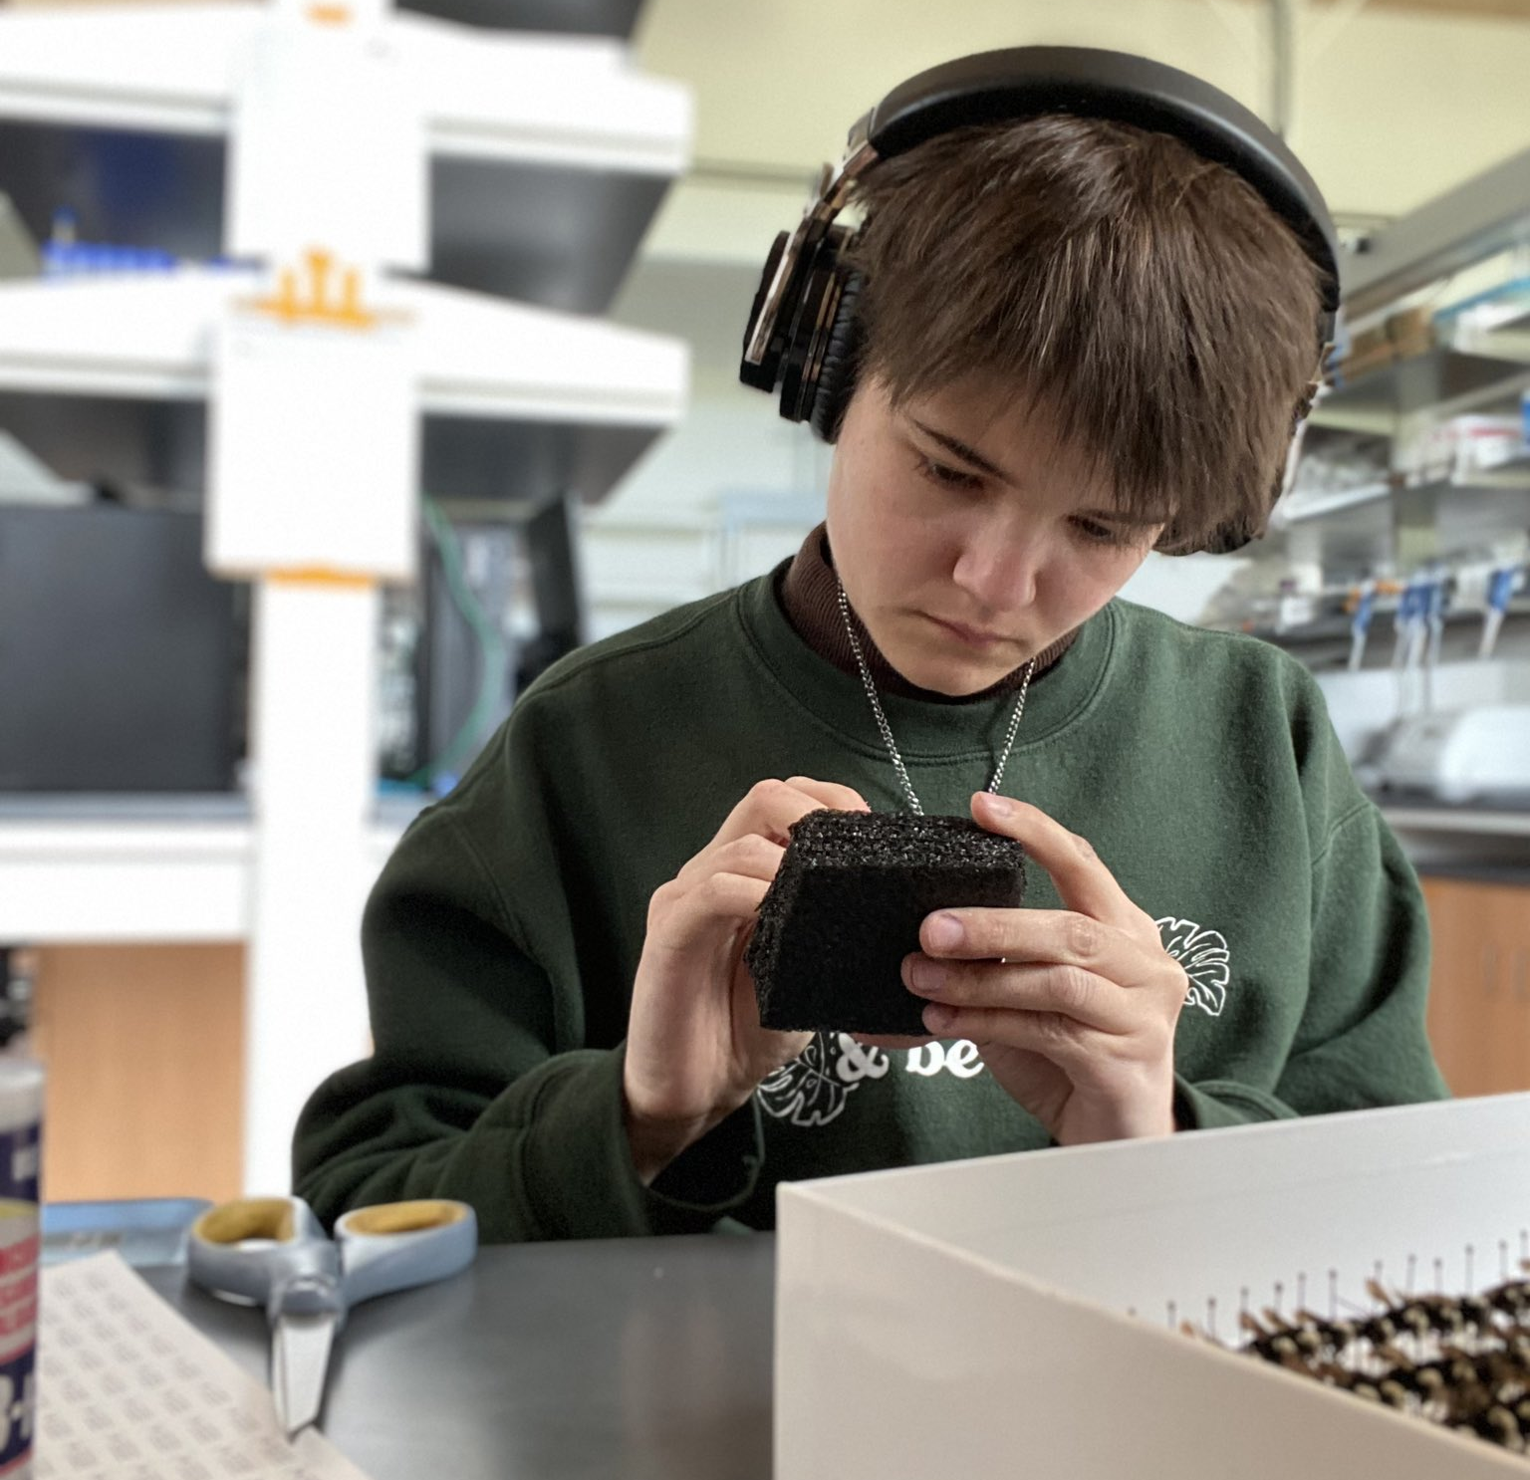
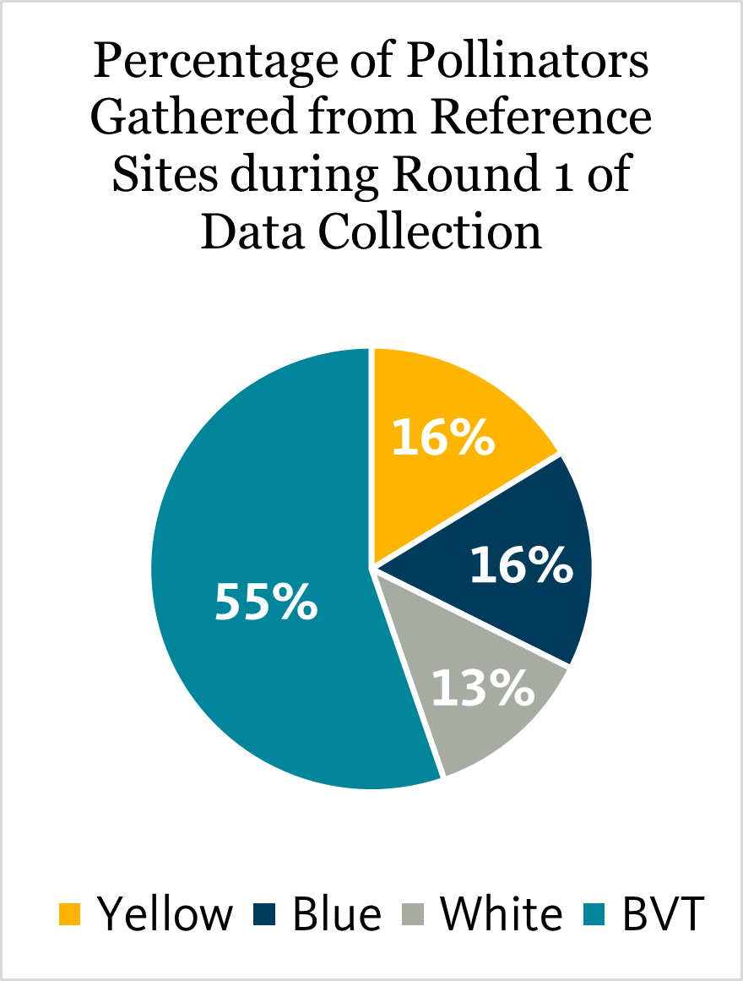
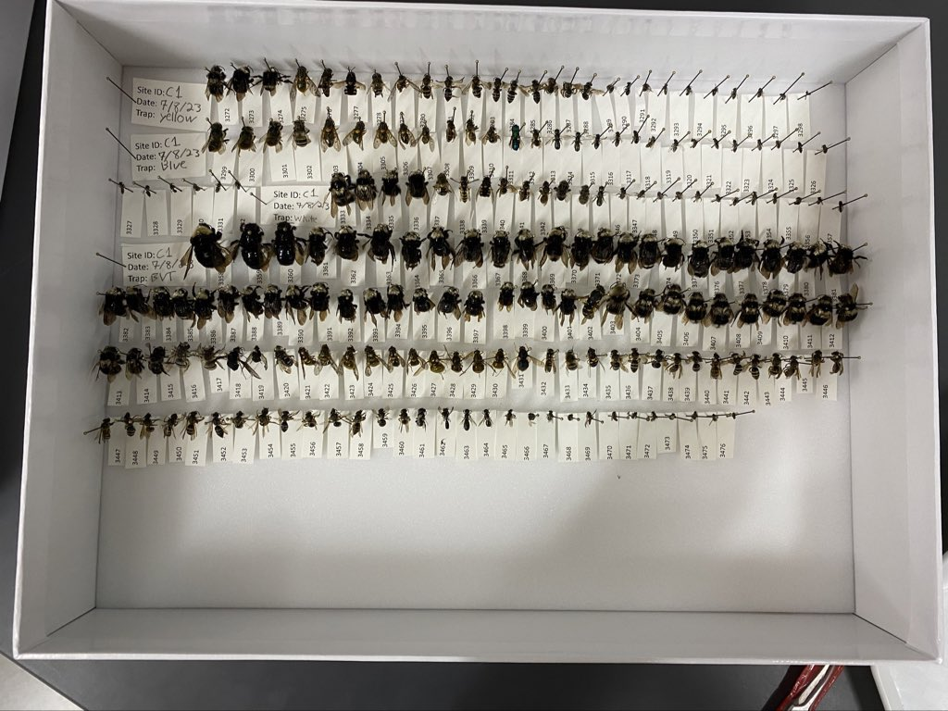
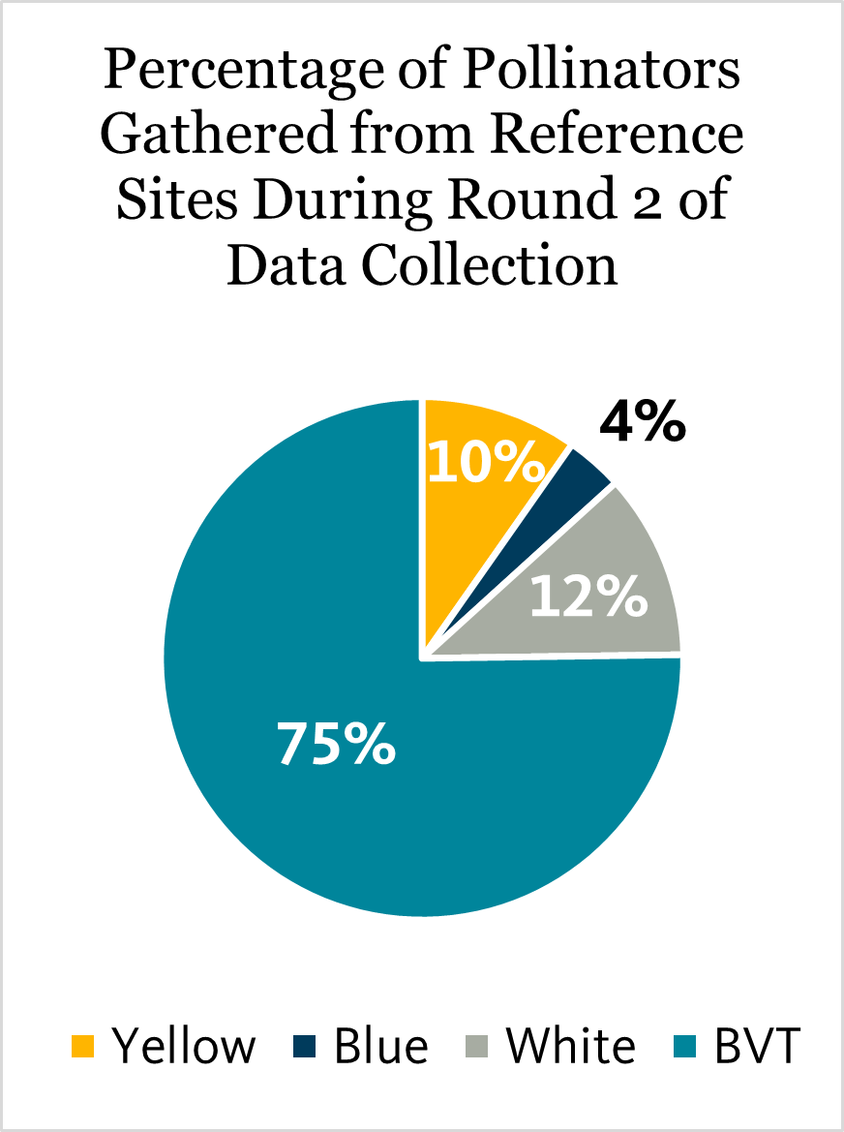
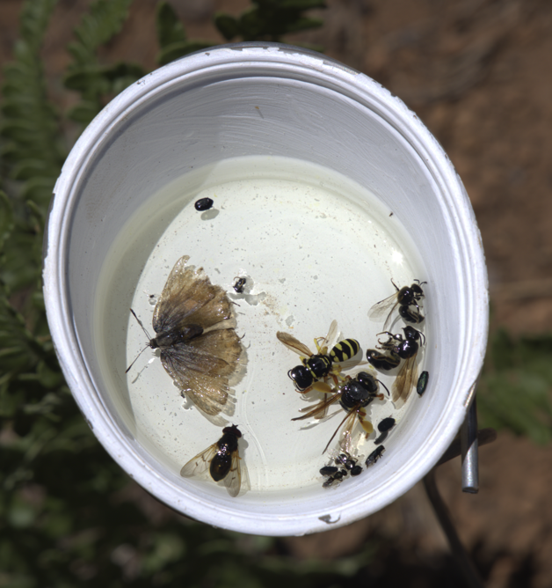
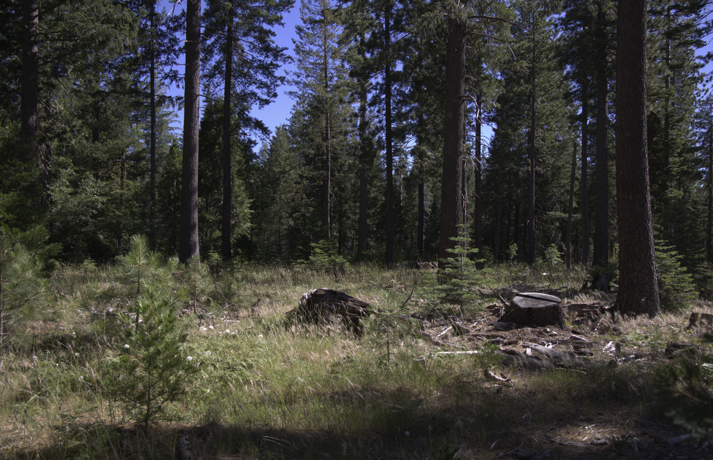
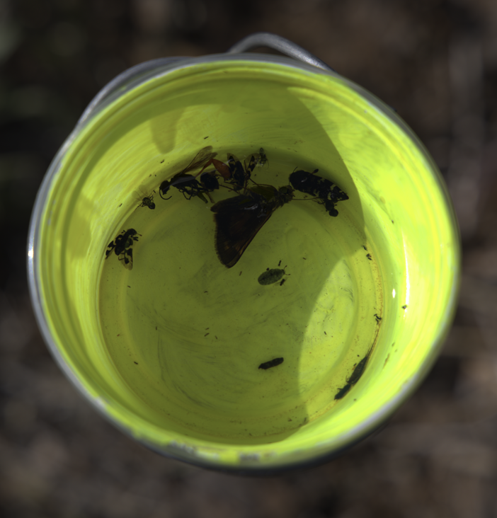
STEM Leaders and the Department of Forest Engineering and Resource Management
COMPARING PASSIVE TRAPPING METHODS FOR SAMPLING FOREST POLLINATORS
Christoph Anderson, Megan Sampognaro, Dr. James W. Rivers
DISCUSSION
INTRODUCTION
Insect pollinators are important for agriculture, where they are well studied.
In contrast, much less is known about forest pollinators, including best approaches for sampling.
As Blue-vane Traps (BVTs) (Fig. 1), have been shown to be the most effective form of pan trapping in agricultural landscapes, I hypothesize that the same will hold true for forested ecosystems.
As for the other pan-trapping methods, I predict that yellow traps (Fig. 2) will be the second most successful, followed by white (Fig. 3) and blue (Fig 4.) due to differing abundance of specimens during processing.
Overall, Blue Vane Traps appear to be the most effective method of pan trapping for pollinator capture (Fig.7) (Fig.8).
However, this is based on abundance and not diversity.
Further evaluation of pollinator collection methods can help scientists determine what they should use when studying different aspects of forest pollinator habits.
METHODS
RESULTS
The location selected for the study is private forest land located northeast corner of California (Fig. 5).
The location had 26 fuel break sites and 8 reference sites to gauge any variation between the plots.
Reference sites were selected to exclude burned or recently logged areas.
Each site had the same amount of trap types used and were out for the same amount of time.
The study used multiple methods to account for biases, including BVTs, Yellow Pan, White Pan, and Blue Pan traps.
The specimens were collected in 2023 in 2 rounds: June-July and July-August.
The specimens were then preserved in ethanol, before being sorted and pinned throughout the ‘23-’24 academic year (Fig. 6).
Figure 7: During round 1, the BVT caught the most specimens, but the combined Yellow, Blue, and White traps nearly match the abundance. The Yellow and Blue traps collected the same percentage of specimens. 45% of the total specimens were everything but the BVT.
Figure 6: An example of what pinned pollinator specimens look like.
ACKNOWLEDGEMENTS
The Forest Animal Ecology Lab team for helping process specimens.
The field team who did the on-the-ground work to collect the pollinators.
W.M. Beaty, Collins Pine and Sierra Pacific industries for providing access to the the land that this study was conducted on.
Figure 8: During Round 2, the BVT collected the vast majority of specimens. The White trap remained largely unaffected by the change in season, but the yellow and blue traps collected drastically less, with 25% of pollinators coming from all other traps.
Figure 1: Blue-vane trap
Figure 3: White Pan trap
Figure 5: Fuel Break
Figure 2: Yellow Pan trap
Figure 4: Blue Pan trap

